Slide 1
TALLY
MADE BY AKKI
STAGE 1 INTRO

Slide 2
Introduction
Tally, crafted with Python, revolutionizes accounting simplicity. This versatile software comes in three editions: Family Tally, Business Tally, and Tally Terminal. Tally, your go-to accounting solution, simplifies financial management with ease. From seamless company creation to secure data handling, Tally ensures a streamlined experience. Enjoy password protection, encryption support, and smart cash management. Currently, the Terminal version is in development, catering specifically to business needs. Elevate your financial management with Tally.

Slide 3
What’s Stage 1
There are certain stages in this tally code that determine the progress and part of the code for help to understand in which part of code we have been talking about or help to know which part of code creating problem…..
1st Stage:- The first stage contains the initial screen of the Tally software. Here, we can create a company, open a company, and select a company. While creating a company, only valid data is accepted and stored for later recall. The stage includes password and encryption support, system info updating, and cash handling.

Slide 4
What’s in Stage 1
Company Management:
Create and open companies.
Manage multiple companies simultaneously.
Data Storage and Security:
Use JSON files for efficient data storage.
Avoid potential security risks with the eval function.
Implement password and encryption support for each company.
Data Validation:
Enforce data validation to prevent invalid entries.
Ensure data integrity.
Documentation and Updates:
Update documentation and information without code re-installation.
Automated checks for updates when companies are opened.
Financial Management:
Support cash updates with valid data, including current currency value.

Slide 5
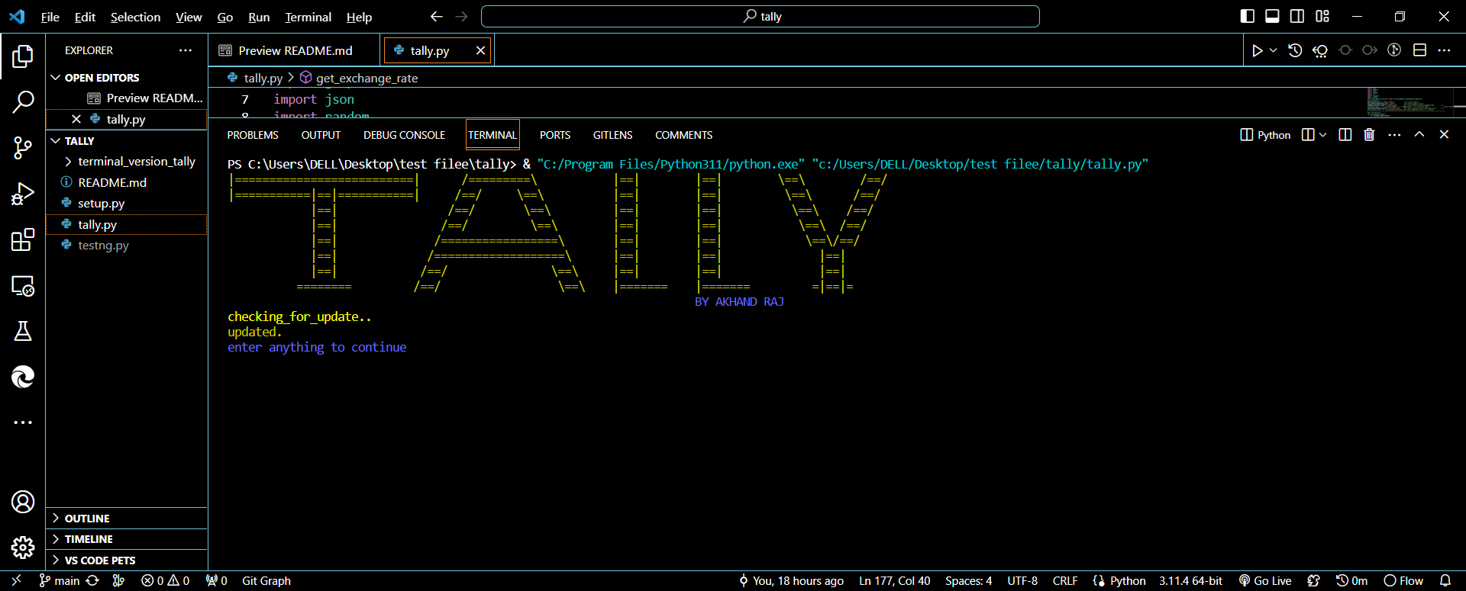
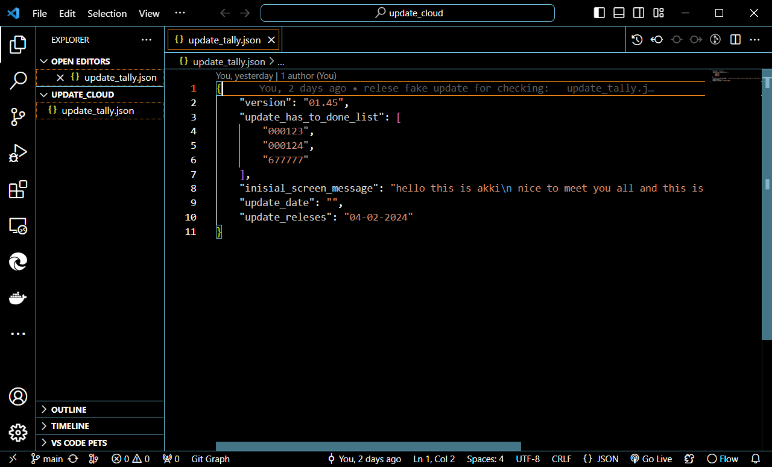
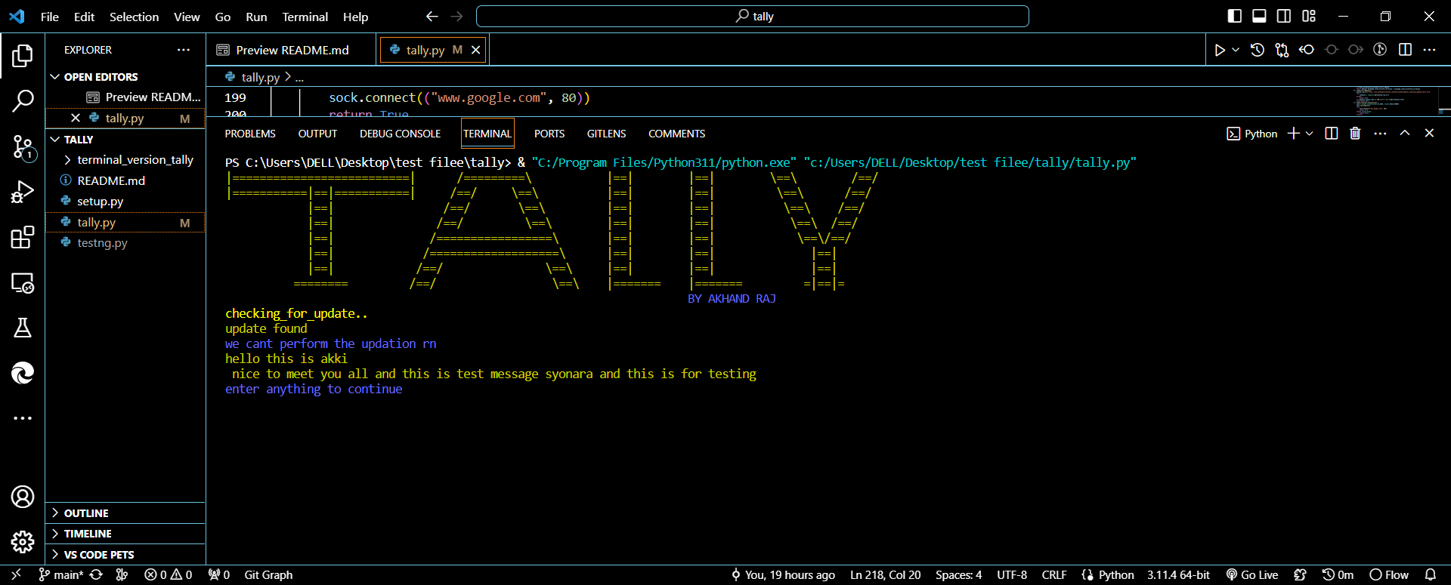
The first page is to check for updates
So the first page checks the update if there is update it’s update the filles define in it
So it’s basically for updation it’s download “JSON” file from git repository then check the update version if it’s similar it’s pass else it’s check what to update and download that specific file from git repository and update it this is how it’s update the software….
Updation:if there is no update screen looks like that
The JSON file to update by reading it it’s update the software
Updation:if there is update and show inisial message regarding update

Slide 6
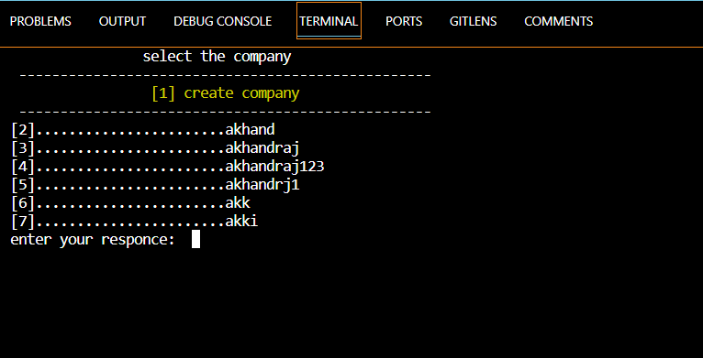
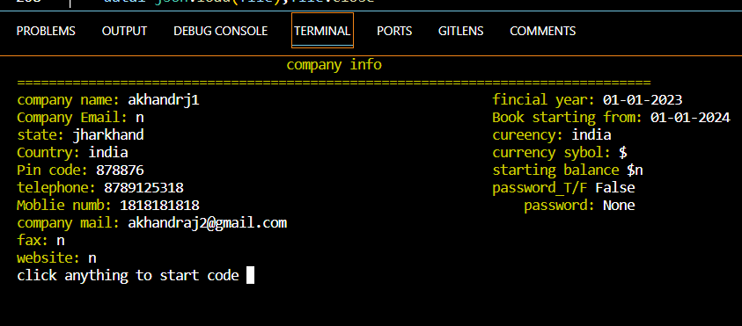
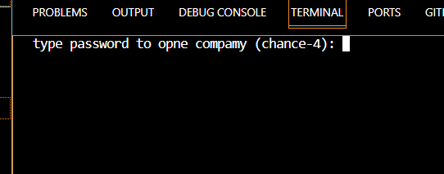
2nd page open or create company…
So the 2nd page is home where we can select company by inputting company serial number and for creating company we type [1] and for other opening company we start with [2] and the last where list end ……
If we select companie…..
If there is password it’s ask password if not 2nd page open
2. After that it’s open company info and there when we enter open G.O.T

Slide 7
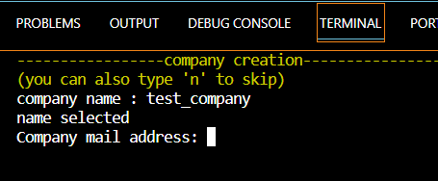
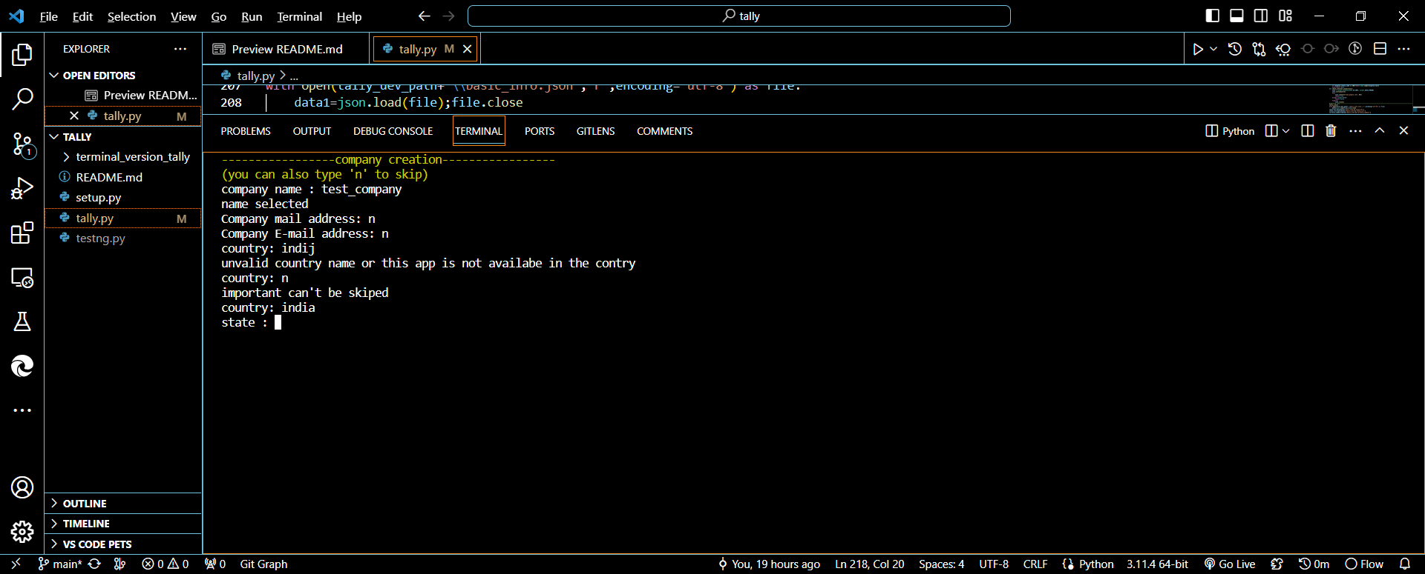
Create Company
So when we click on create company we get a form to like that a after filling it they show us all info and ask if it’s you want to if yes all info save and com created if not u get the form again
When u filing the form u can input ‘n’ in create company and that will bring u again to select company page
If you click ‘n’ in other section of form it’s will skip that part of info
If you enter ‘wrong info’ in form such as wrong number wrong mail wrong state and country name etc. it will show an error message and ask you to fill that detail again
After u finish with the form it’s ask for password while typing password u can’t see it and after that
It will ask last detail if u entered is current or not if you type ‘y’ company created and if you type ‘n’ you get form again
All time of input an dresponse

